Slide 1
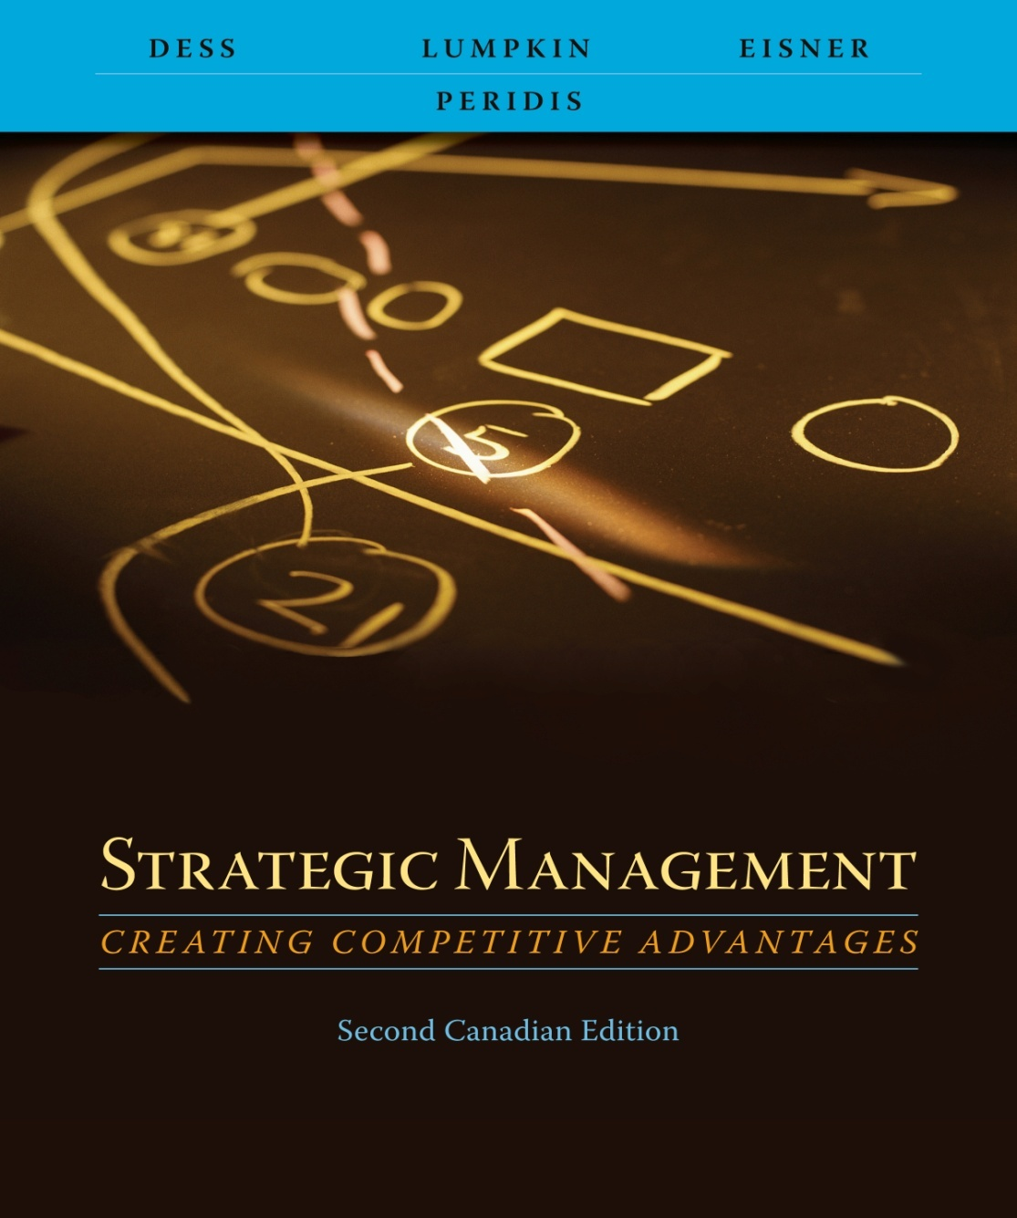
Chapter 6
Cooperative-Level Strategy:
Creating Value Through Diversification

Slide 2
Learning Objectives
After reading this chapter, you should have a good understanding of:
  Why firms engage in diversification efforts and how managers can create value through diversification initiatives.
  How corporations can use related diversification to achieve synergistic benefits through economies of scope and market power.
  How corporations can use unrelated diversification to achieve synergistic benefits trough corporate restructuring, parenting, and portfolio analysis.
  The various means of engaging in diversification: mergers and acquisitions, strategic alliances and joint ventures, internal development.
  The value of real options analysis (ROA) in making resource allocation decisions under conditions of high uncertainty.
  The reason for the failure of many diversification efforts.

Slide 3
Making Diversification Work
What businesses should a corporation compete in?
How should these businesses be managed to jointly create more value than if they were freestanding units?

Slide 4
Making Diversification Work
Diversification initiatives must create value for shareholders
  Mergers and acquisitions
  Strategic alliances
  Joint ventures
  Internal development
Diversification should create synergy
= 1
+
> 2
Business 1
Business 2

Slide 5
Synergy
Related businesses : horizontal relationships
  Sharing tangible resources
  Sharing intangible resources
Specialized skills
Manufacturing facilities
Patents, copyrights, etc.
Production facilities
Distribution channels
Favorable reputation
Business 1
Business 2

Slide 6
Synergy
Unrelated businesses (hierarchical relationships)
  Value creation derives from corporate office
  Leveraging support activities
Human resource mgmt
Firm infrastructure
Business 2
Technology development
Procurement
Information systems
Business 1

Slide 7
Creating Value
Related Diversification
Leveraging core competencies
  3M leverages it competencies in adhesives technologies to many industries, including automotive, construction, and telecommunications
Sharing activities
  McKesson, a large distribution company, sells many product lines, such as pharmaceuticals and liquor, through its super warehouses
Pooled negotiating power
  The Times Mirror Company increases its power over customers by providing “one-stop shopping” for advertisers to reach customers through multiple media (television and newspapers) in several huge markets such as New York and Chicago
Vertical integration
  Shaw industries, a giant carpet manufacturer, increases its control over raw materials by producing much of its own polypropylene fiber, a key input to its manufacturing process
Exhibit 6.1 Creating Value through Related and Unrelated Diversification

Slide 8
Creating Value
Unrelated Diversification: Parenting, Restructuring, and Financial Synergies
Corporate restructuring and parenting
  The corporate office of Cooper Industries adds value to its acquired businesses by performing such activities as auditing their manufacturing operations, improving their accounting activities, and centralizing union negotiations
Portfolio management
  Novartis, formerly Ciba-Geigy, uses portfolio management to improve many key activities, including resource allocation and reward and evaluation systems
Exhibit 6.1 Creating Value through Related and Unrelated Diversification

Slide 9
Related Diversification: Economies of Scope and Revenue Enhancement
Economies of scope
  Cost savings from leveraging core competencies or sharing related activities among businesses in the corporation
  Leverage or reuse key resources
    Favorable reputation
    Expert staff
    Management skills
    Efficient purchasing operations
    Existing manufacturing facilities

Slide 10
Leveraging Core Competencies
Core Competencies
  The glue that binds existing businesses together
  Engine that fuels new business growth
  Collective learning in a firm
    How to coordinate diverse production skills
    How to integrate multiple streams of technologies
    How to market diverse products and services

Slide 11
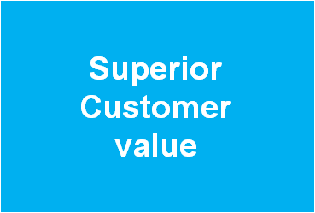
Three Criteria of Core Competencies
Three criteria (of core competencies) that lead to the creation of value and synergy
  Core competencies must enhance competitive
  advantag by creating superior customer value
    Develop strengths relative to competitors
    Build on skills and innovations
    Appeal to customers
  Different businesses in the firm must be similar in at
  least one important way related to the core
  competence
    Not essential that products or services themselves be similar
    Is essential that one or more elements in the value chain require similar essential skills
    Brand image is an example
Businesses similar in way related to core competency

Slide 12
Three Criteria of Core Competencies
  Core competencies must be difficult for competitors to imitate or find substitutes for
    Easily imitated or replicated core competencies are not a sound basis for sustainable advantages
    Specialized technical skills acquired only in company work experience are an example
Difficult to imitate or find substitutes for

Slide 13
Sharing Activities
Corporations can also achieve synergy by sharing tangible and value-creating activities across their business units
  Common manufacturing facilities
  Distribution channels
  Sales forces
Sharing activities provide two payoffs
  Cost savings
  Revenue enhancements

Slide 14
Cost Savings through Sharing Activities
Most common type of synergy
Savings obtained through
  Eliminating duplicate jobs
  Eliminating duplicate facilities
  Eliminating related expenses
Savings may be offset by
  Greater costs of coordinating shared activities
  Costs of compromising design or performance of a shared activity

Slide 15
Enhancing Revenue through
Sharing Activities
Acquiring firm and its target may achieve a higher level of sales growth together than either could have achieved on its own
  Combined distribution channels can escalate sales of the acquiring company’s products
  Enhanced effectiveness of differentiation strategies
Can have a negative effect on a given business’s differentiation

Slide 16
Vertical Integration
Dependency
Suppliers
Customers
Benefits
  Secure source of supply of raw materials
  Secure distribution channels
  Protection and control over assets and services
  Access to new business opportunities and technologies
  Simplified procurement and administrative procedures
Business 2
Dependency
Dependency
Suppliers
Customers
Business 1

Slide 17
Vertical Integration
Risks
  Costs and expenses associated with increased overhead and capital expenditures
  Loss of flexibility resulting from inability to respond quickly to changes in the external environment
  Problems associated with unbalanced’ capacities or unfilled demand along the value chain
  Additional administrative costs
Business 2
Dependency
Business 1

Slide 18
Vertical Integration: Benefits and Risks
Benefits
A secure source of raw materials or distribution channels.
Protection of and control over valuable assets.
Access to new business opportunities
Simplified procurement and administrative procedures.
Risks
Costs and expenses associated with increased overhead and capital expenditures
Loss of flexibility resulting from large investments.
Problems associated with unbalanced capacities along the value chain.
Additional administrative costs associated with managing a more complex set of activities.
Exhibit 6.3 Benefits and Risks of Vertical Integration

Slide 19
Vertical Integration
In making decisions associated with vertical integration, four issues should be considered:
  Are we satisfied with the quality of the value that our present suppliers and distributors are providing?
  Are there activities in our industry value chain presently being outsourced or performed independently by others that are a viable source of future profits?
  Is there a high level of stability in the demand for the organization’s products?
  How high is the proportion of additional production capacity actually absorbed by existing products or by the prospects of new and similar products?

Slide 20

Corporate Parenting
Parenting—creating value within business units
  Experience of the corporate office
  Support of the corporate office
Plans
Budgets
Procurement
Legal functions
Financial functions
Human resource management
Business unit
Business unit
Business unit

Slide 21
Corporate Restructuring
Find poorly performing firms
  With unrealized potential
  On threshold of significant positive change
Corporate office
Sell off parts
Reduce payroll
Change strategies
Change management
Infuse new technologies
Reduce unnecessary expenses
Business unit
Business unit
Business unit
Business unit
Business unit
Business unit

Slide 22
Corporate Restructuring
Corporate management must
  Have insight to detect undervalued companies or businesses with high potential for transformation
  Have requisite skills and resources to turn the businesses around
Restructuring can involve changes in
  Assets
  Capital structure
  management

Slide 23
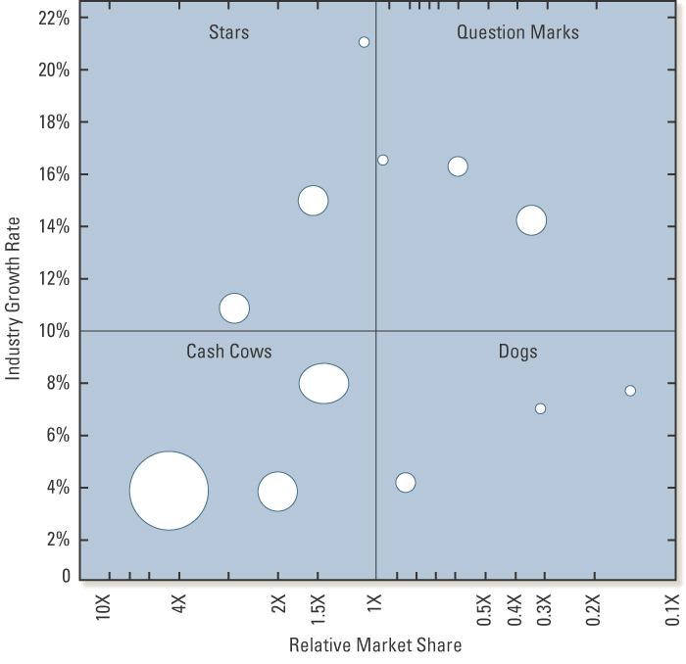
Portfolio Management
Each circle represents one of the firm’s business units
Size of circle represents the relative size of the business unit in terms of revenue

Slide 24
Portfolio Management
Creation of synergies and shareholder value by portfolio management and the corporate office
  Allocate resources (cash cows to stars and some question marks)
  Expertise of corporate office in locating attractive firms to acquire
Creation of synergies and shareholder value by portfolio management and the corporate office
  Provide financial resources to business units on favorable terms reflecting the corporation’s overall ability to raise funds
  Provide high quality review and coaching for units
  Provide a basis for developing strategic goals and reward/evaluation systems

Slide 25
Means to Achieve Diversification
1. Acquisitions or mergers
2. Pooling resources of other companies with a firm’s own resource base
  Joint venture
  strategic alliance
3. Internal development
  New products
  New markets
  New technology

Slide 26
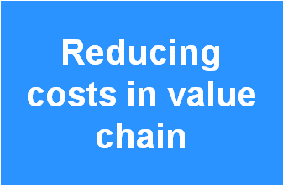
Strategic Alliances and Joint Ventures
Introduce successful product or service into a new market
  Lacks requisite marketing expertise
    Doesn’t understand customer needs
    Doesn’t know how to promote the product
    Doesn’t have access to proper distribution channels
Entering new markets
Join other firms to reduce manufacturing (or other) costs in the value chain
  Pool capital
  Pool value-creating activities
  Pool facilities
Economies of scale

Slide 27
Strategic Alliances and Joint Ventures
Develop or diffuse new technologies
  Use expertise of two or more companies
  Develop products technologically beyond the capability of the companies acting independently
Developing diffusing new technology

Slide 28
Unmet Expectations: Strategic Alliances and Joint Ventures
Improper partner
  Each partner must bring desired complementary strengths to partnership
  Strengths contributed by each should be unique
Partners must be compatible
Partners must trust one another

Slide 29
Real Options Analysis
Stock options (financial assets)
Real options ( real assets or physical things)
  Investments can be staged
  Strategic decision-makers have “tollgates”
  Increased knowledge about outcomes at the time of the next investment decision

Slide 30
Managerial Motives Can Erode
Value Creation
Growth for growth’s sake
Egotism
Anti-takeover tactics
  Greenmail
  Golden parachute
  Poison pills

